Slide 1
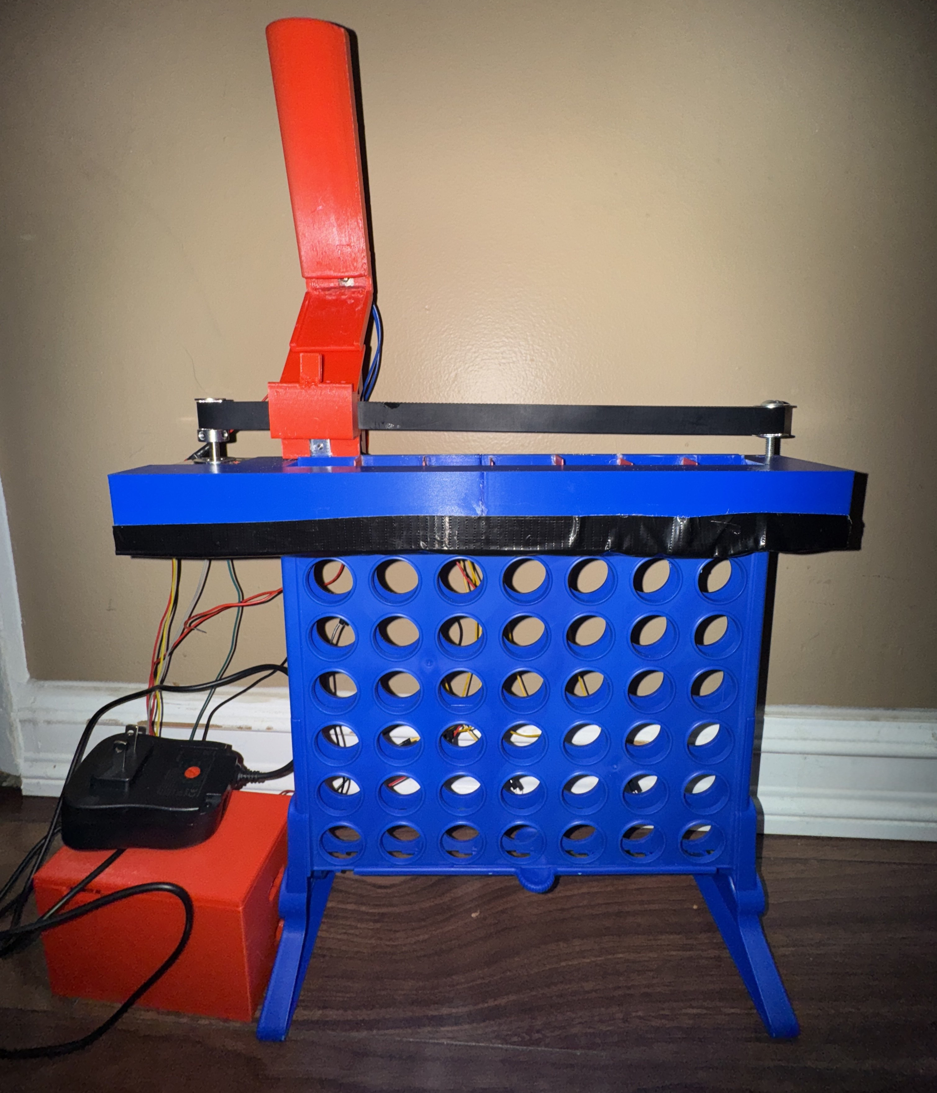
Automatic Connect 4
By:
Adrian Baira
And
Naresh Koirala
Notes:
Good afternoon everyone we're excited to pre sent out project: an automated connect 4 games that drops tokens on a physical game board for online play or with a bot. I’m Adrian Baira, joined by Naresh Koirala. Let’s show you how we made this classic game be more interactive and excited.

Slide 2

Outline
Overview
Software
Hardware
Challenges
Results
Conclusion
Questions

Slide 3
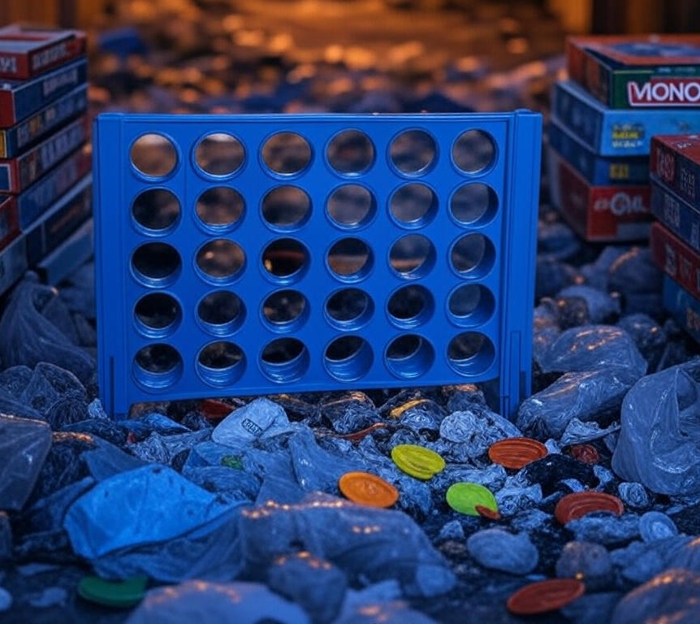
Look Familiar?
Notes:
Does this look familiar?

Slide 4

Master Connect 4 Anywhere
Want to revive an old Connect 4 board?
Play online with a modern twist!
Notes:
Got an old Connect 4 board gathering dust? What if you could transform it into a high-tech game that drops red tokens for online battles or bot practice? That’s our project! We automated a classic board to let you play and practice globally, bringing new life to an old favorite!

Slide 5
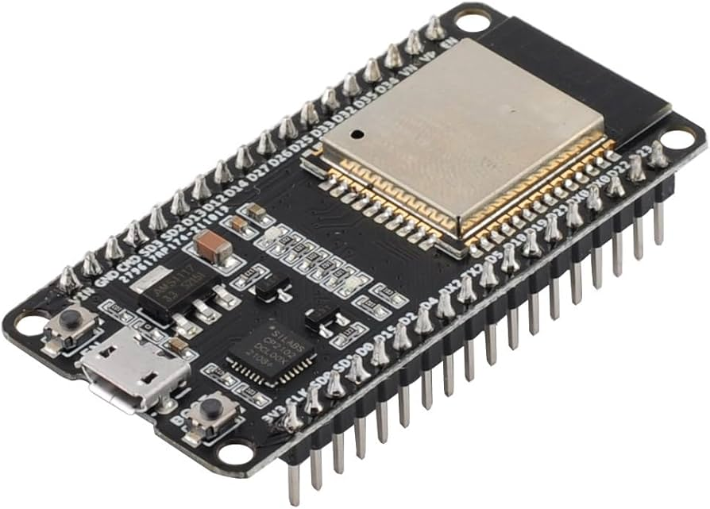
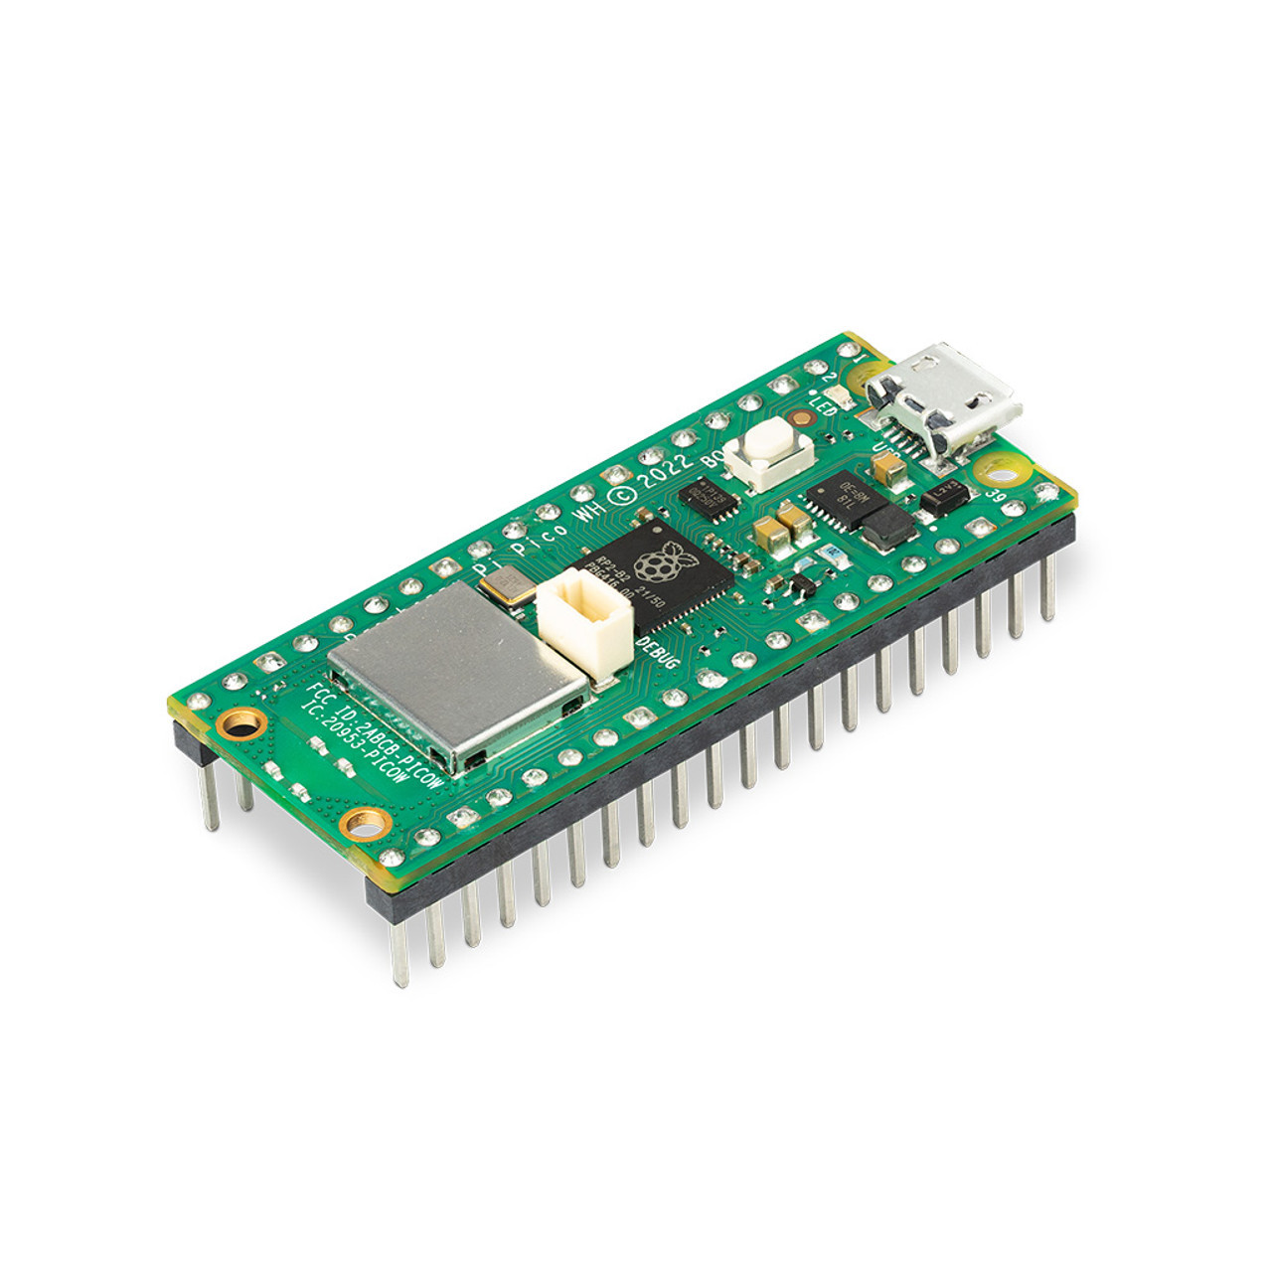

Overview
Purpose: Automate Connect 4 for online practice and play
Features: Token detection, bot or player mode, Portable.
Tools used: Raspberry Pi Pico W, ESP-32, MQTT

Slide 6
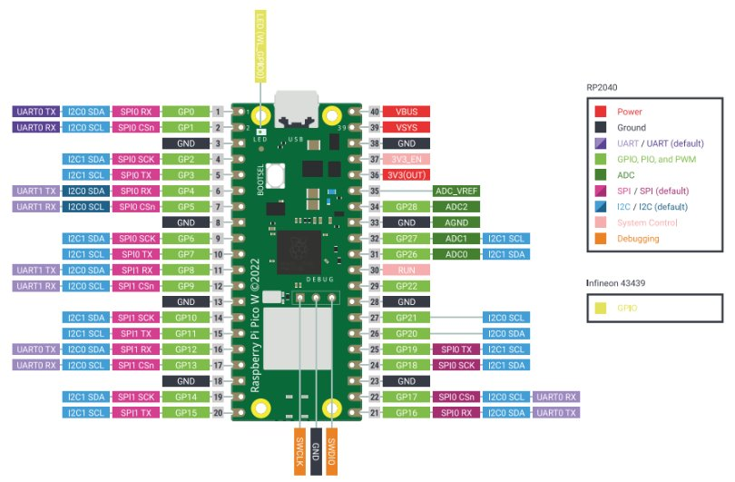
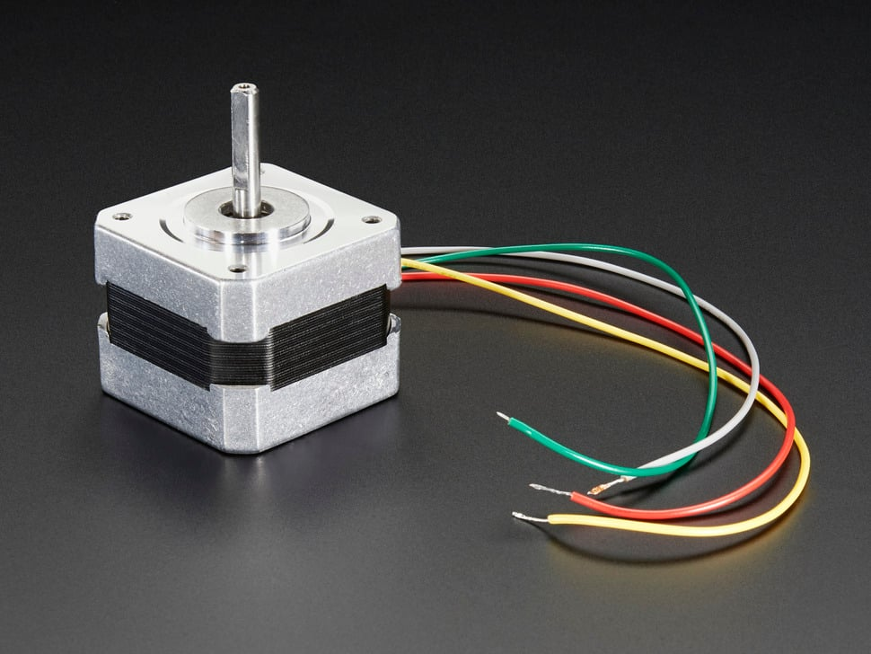
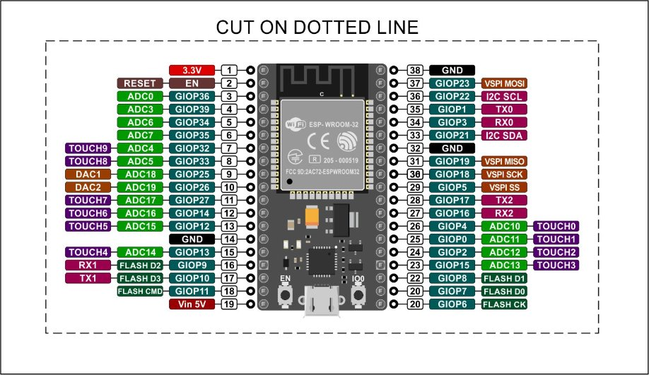
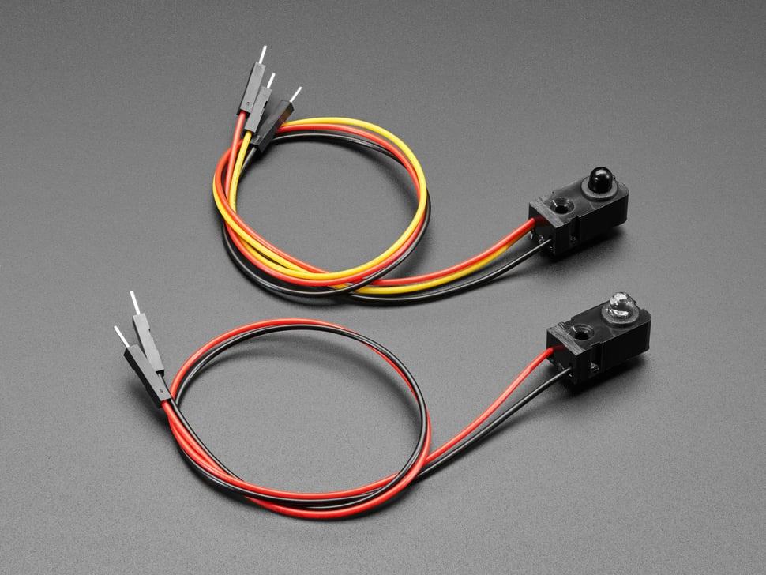
Hardware
Microcontrollers:
Raspberry Pi Pico W
ESP32
Components:
TIP122 MOSFET
1N3604 transistor
2 solenoids
12V stepper motor
7 laser break sensors

Slide 7
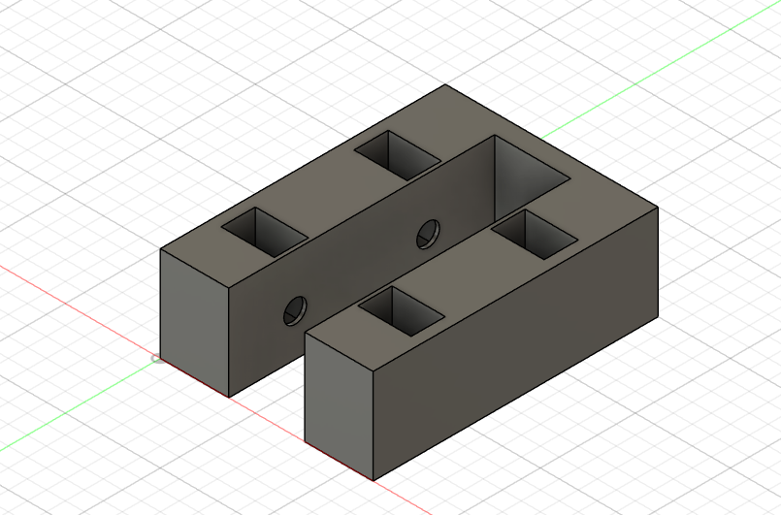
Token Detection Sent to Website

Slide 8
Motor Movement and Token Dispenser

Slide 9
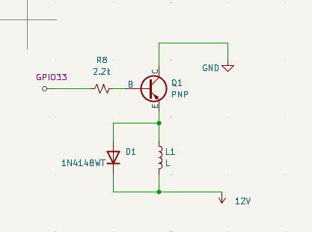
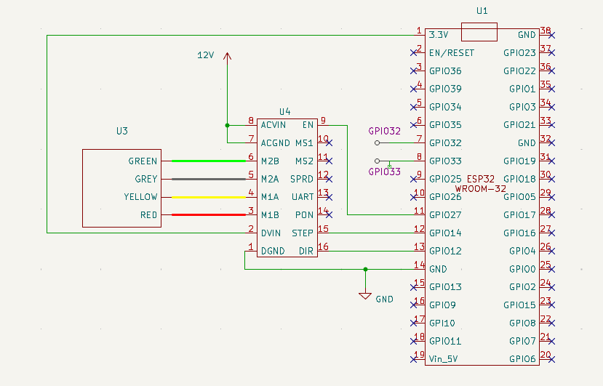
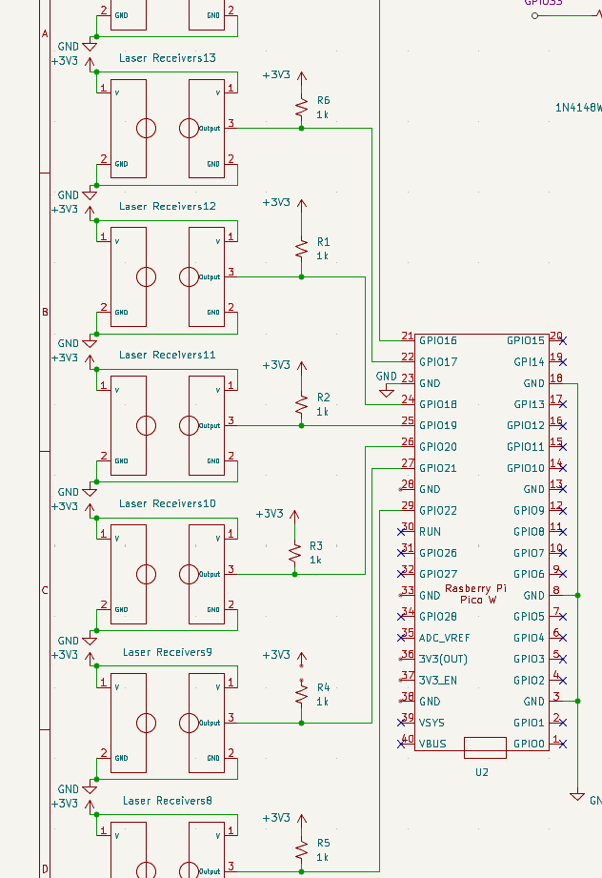
Wiring Diagram

Slide 10
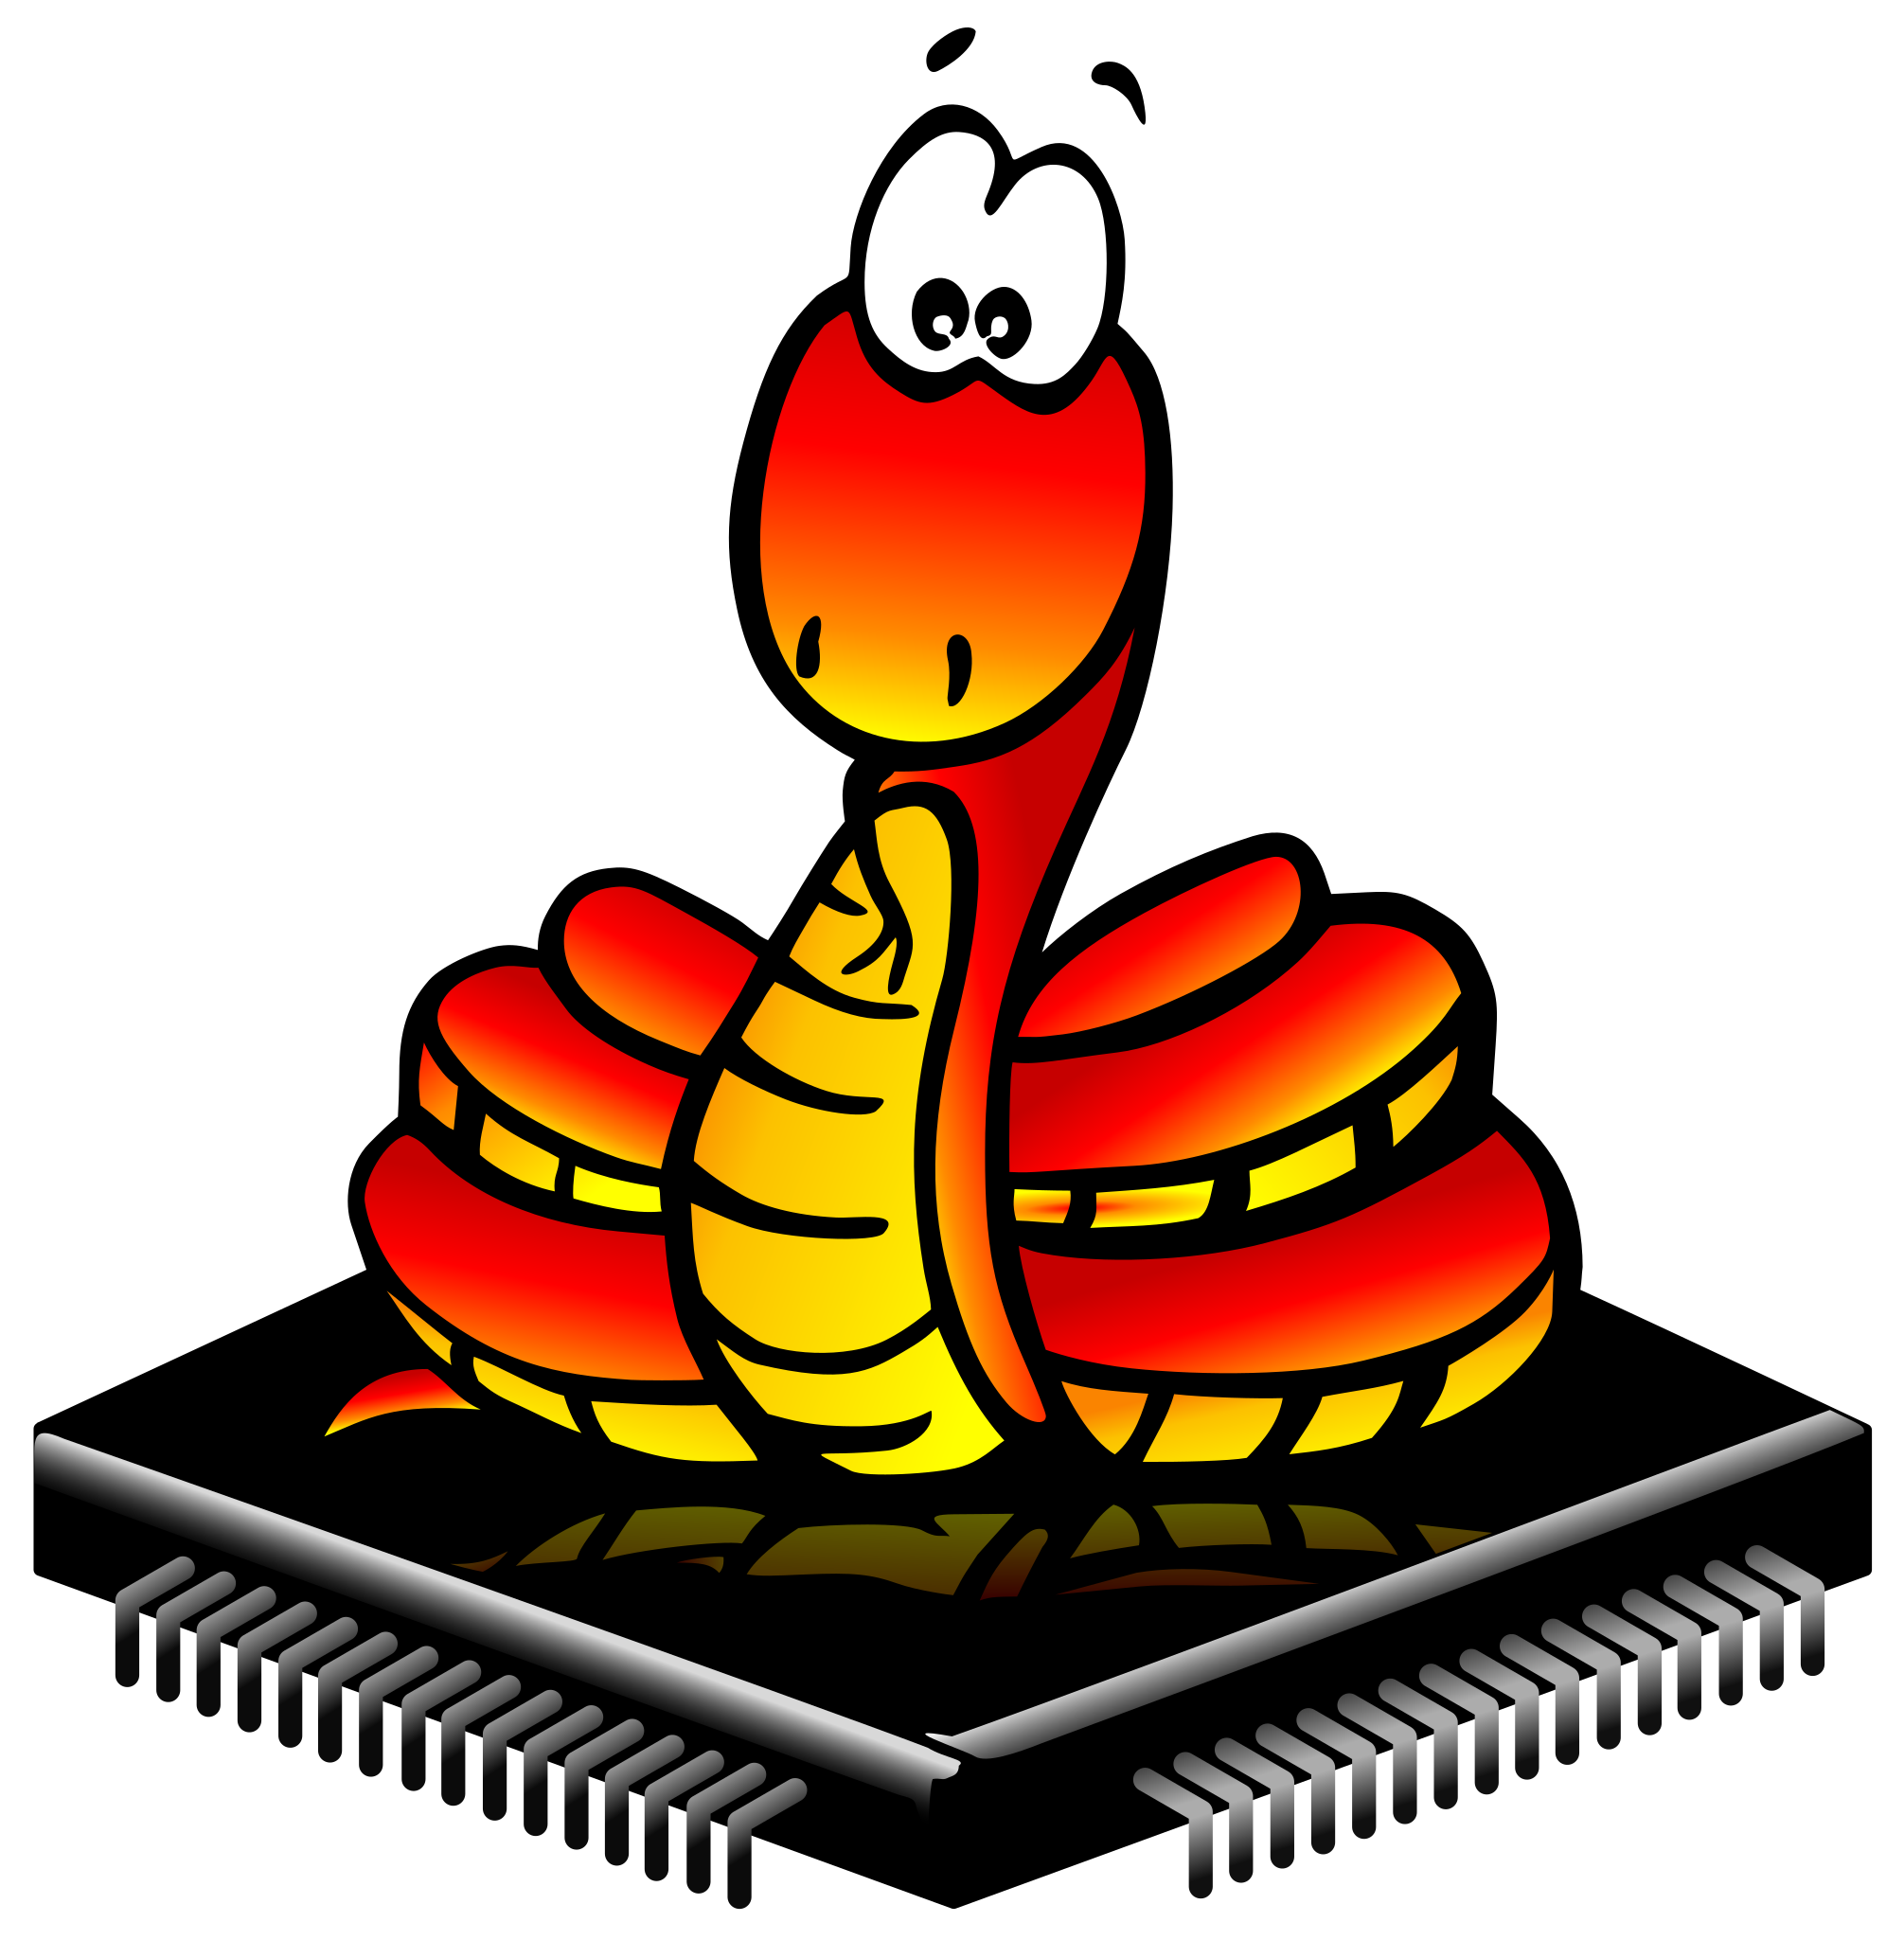


Software
MicroPython:
Controls Pico W, ESP32
HTML, CSS, JavaScript:
Live game feed
Fusion 360:
3D design for rail, sensors
Notes:
Our software stack drives automation and connectivity. MicroPython runs on the Pico W managing the sensors and the ESP-32 controls the motor, bot logic and hosting a website with MQTTT for efficient control. HTML, CSS, and JavaScript power the ESP32’s webserver, delivering a live game feed for real-time play. Fusion 360 was used to design the sensor mounts, token holder, and dispensor

Slide 11
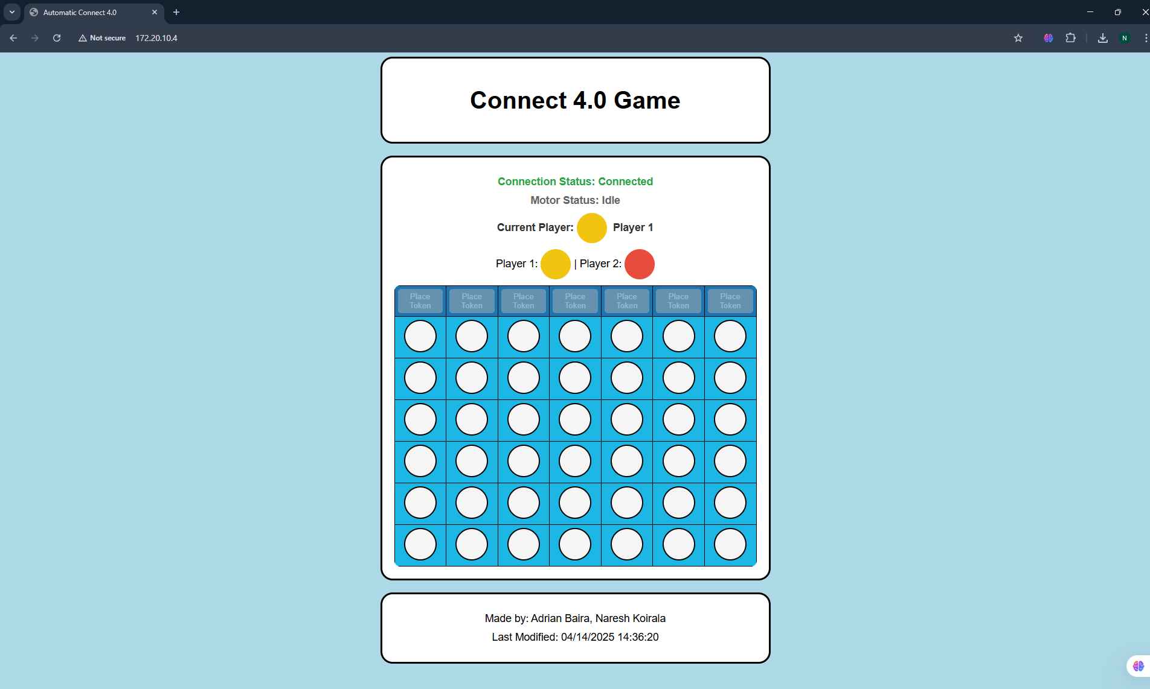
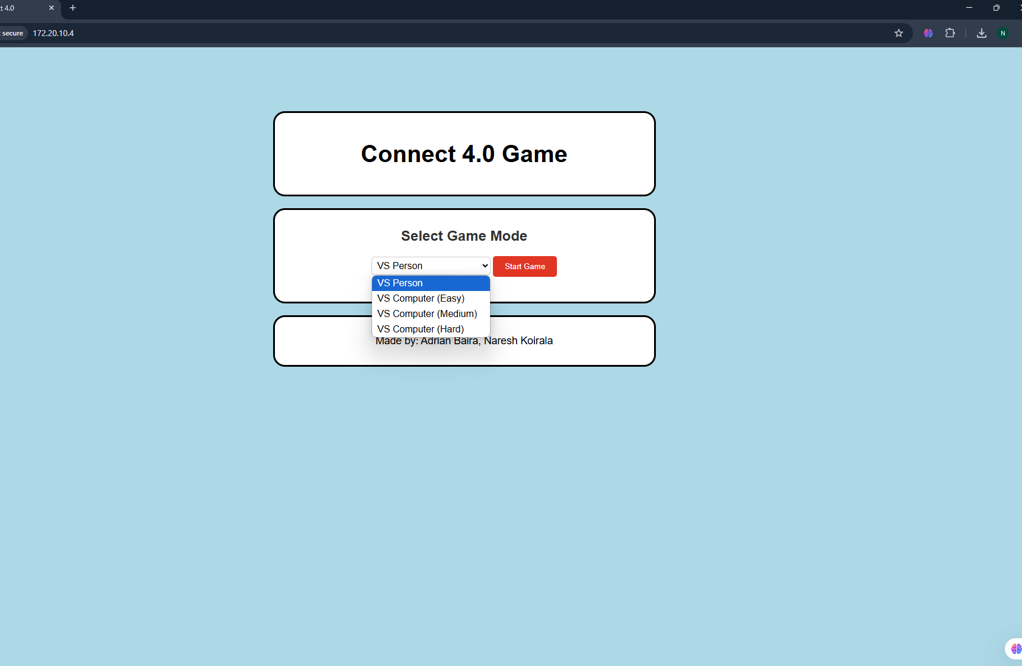
Website

Slide 12
Computer Bot

Slide 13
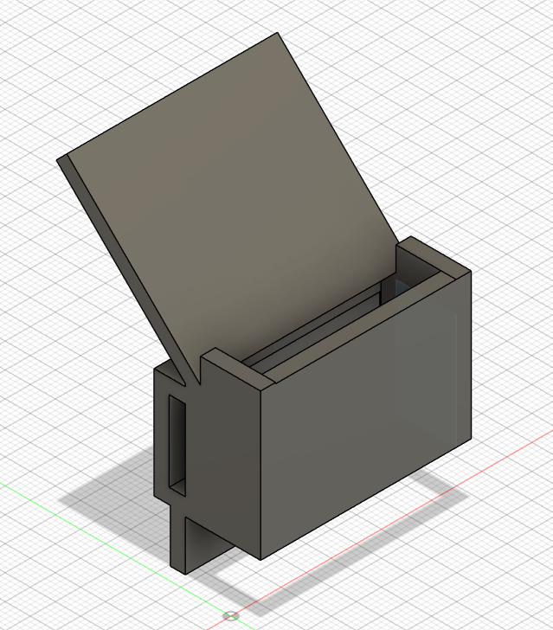

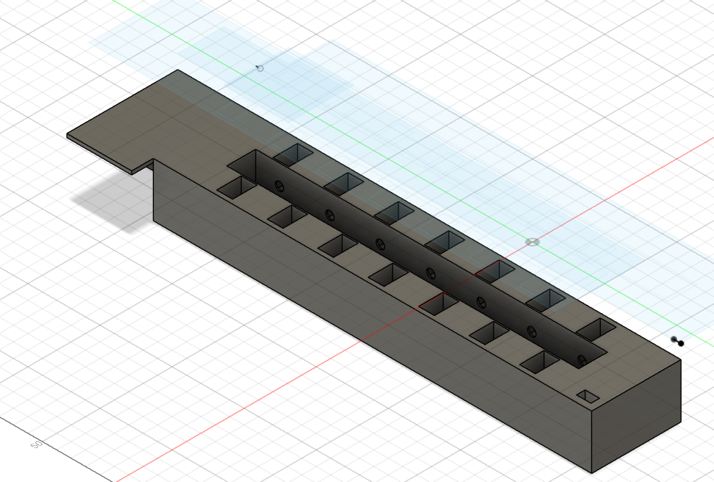
Challenges
-MQTT connectivity:
Linking two boards
-3D design:
Sensor placement, rail system
-Building a bot:
AI logic integration
Notes:
We faced three challenges. First, connecting two boards via MQTT was tough due to network reliability. We configured Mosquitto on port 1883 with anonymous access for stable communication. Second, the 3D design for seven laser break sensors and the rail system needed precision; iterative prototyping ensured alignment. Third, building a bot’s AI logic was complex for real-time play; we implemented a basic algorithm to enable practice, with plans for future enhancement.

Slide 14
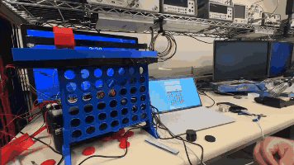
Results
Achievements:
Token dropping, dispensing
Correct token placement
Live game feed
Future Improvements:
Advanced bot logic
Mobile app
Smoother mechanics
Notes:
The project is able to successfully drop and dispesnses tokens, in places them into the correct positions, and provide a live game feed for real-time play. Players are able to practice with a bot or compete online globally, all on a reused board. Looking ahead, we’d enhance the bot for smarter play, develop a mobile app for easier access, and refine the rail and solenoids for smoother token drops

Slide 15
References
https://datasheets.raspberrypi.com/picow/pico-w-datasheet.pdf
https://ontremdkmiwiring.z21.web.core.windows.net/esp32-wroom-32d-arduino-ide-board.html
https://medium.com/swlh/mqtt-how-iot-devices-talk-to-each-other-7b363da3ebf

